Slide 1
Theme Option 1

Slide 2
PRE - EVENT
A. MAILERS
Block Your Date Mailer
Destination Reveal Mailer
Engagement / Excitement Mailer
Countdown Mailer
GIF Mailer
Activity Mailer
Video Mailer
Pack Your Bag Mailer

Slide 3


Reference Mailer
GET READY TO
JOIN THE EPITOME OF
LUXURY AT GRAND HYATT
A friendly reminder:
There are additional accommodation charges for prolonged stays beyond the event at Grand Hyatt Goa .
5th-7th AUG’24

Slide 4



Video Mailer Reference
TOUCH DOWN AND BRACE YOURSELF
FOR AN EXCITING JOURNEY AHEAD!
Here’s your quick guide to navigate the airport like a pro:
Proceed directly to the immigration counter to complete the immigration clearance
STEP 1
STEP 2
Collect Baggage
Exit from Exit C and proceed to Gate no. 3 without changing floors or going roadside
STEP3
STEP4
Find Medtronic placard at Gate no. 3 within the airport premises
An airport representative will promptly assist you and summon the driver , ensuring a wait time not more than 15 minutes .
STEP 5
STEP 6
Enjoy a non-stop transfer to the hotel by the designated driver.

Slide 5


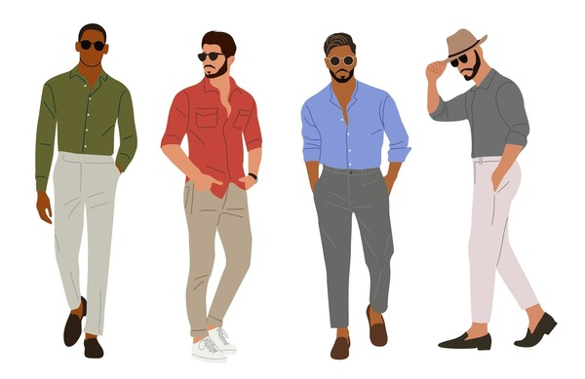
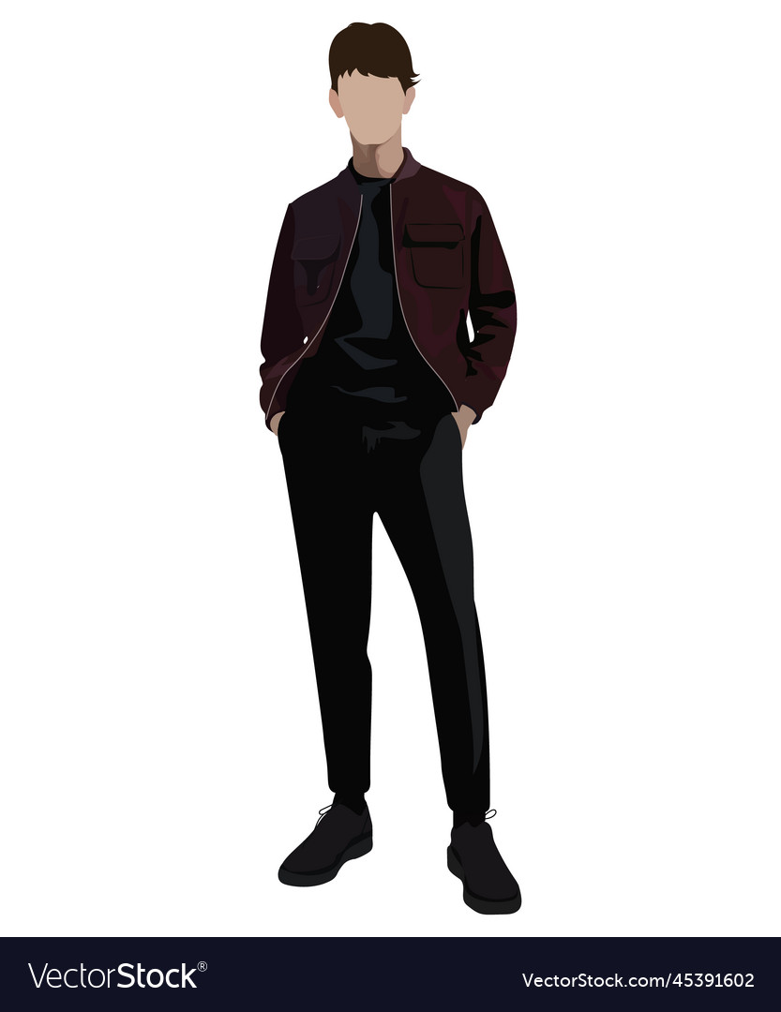

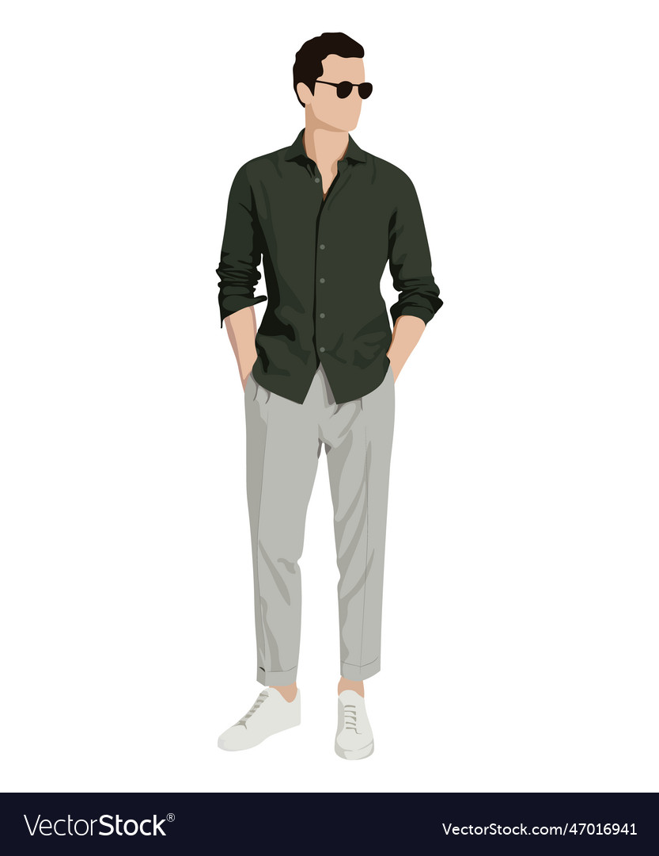
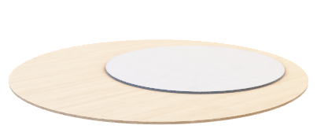



Looking forward to welcome you all to India Kickoff Meet
Please refer to the following dresscode to arrive in style!
Day 1 – Sundowner Party
Day 3 – Masquerade Party
Smart
Casuals
Day 2– Cruise Party
Smart
casuals
Summer
Wear

Slide 6


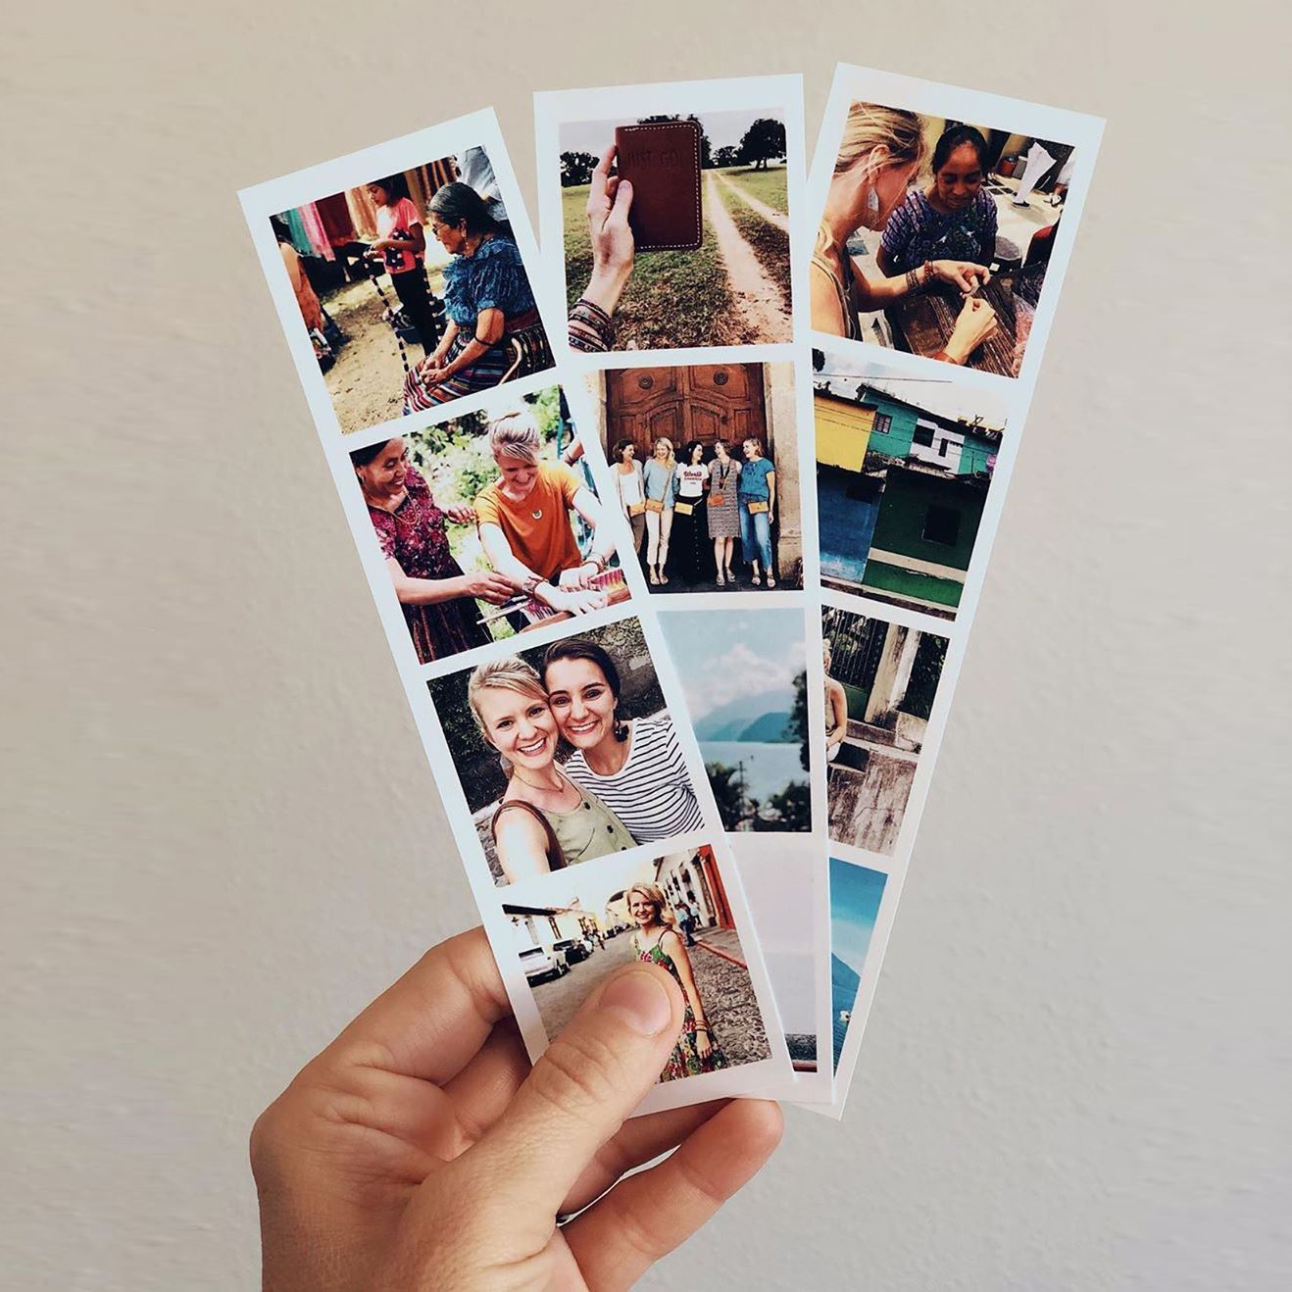
PRE-EVENT-ACTIVATION ON PREMISE
B. Employee Engagements in Various Offices
Thematic Destination Photo OP Installation
Destination Unveil Activity
Office Engagement
Activities
Duration 2/3 Weeks
Duration – One day
Duration – One day

Slide 7





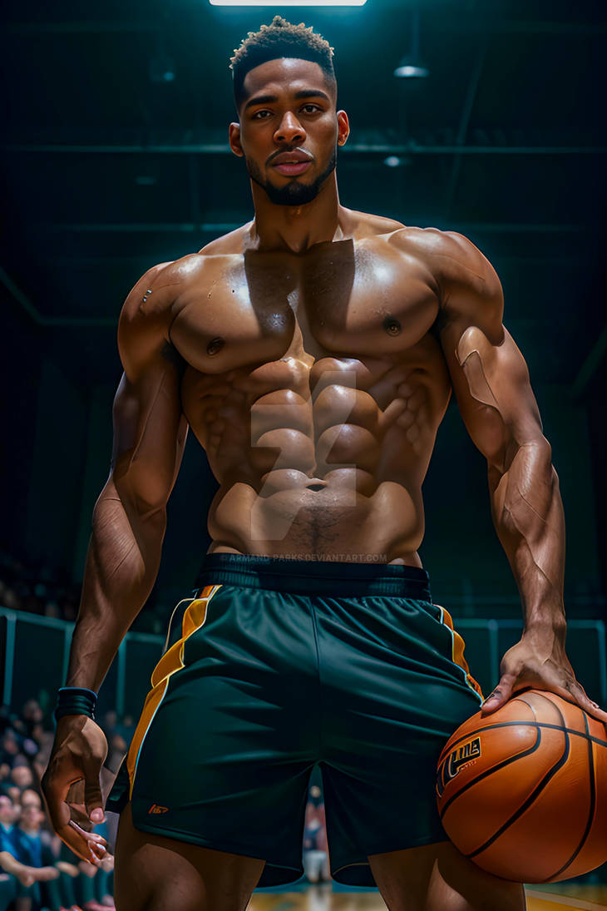

OFFICE ENGAGEMENT
1. AI PHOTOBOOTH
Will select a theme could be – Space, Movies, Sports and get yourself clicked in that theme.

Slide 8

OFFICE ENGAGEMENT
2. PHOTO STRIP BOOTH
Get clicked with yourself & with collogues and get a strip full of pictures.

Slide 9
AGENDA
5th Aug | 6th Aug
Welcome Experience- Goan Theme | Plenary Sessions-KOM Theme
Lunch- Goan Delicacies | Lunch
OU Breakout sessions- Individual Divisions | Award Night- Game Changers Gala
7th Aug
Checkout & Departure

Slide 10
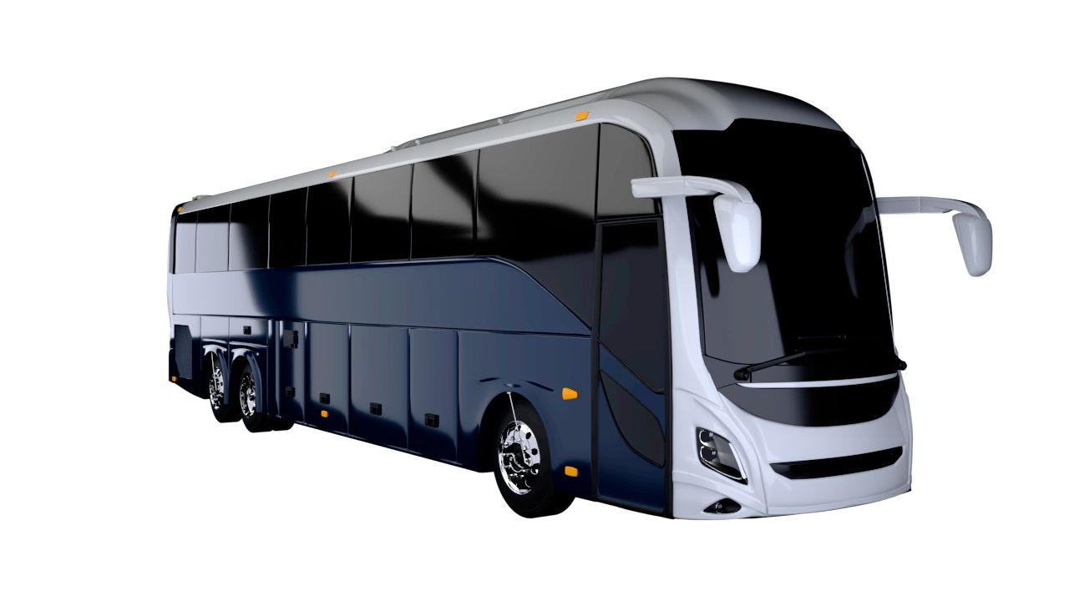

AIRPORT TRANSFERS
F25
FY25
Medtronic
Hospitality Team will be wearing t-shirts
AT Arrival, representative escorts the employees to the coaches.
Porters assist them with their luggage.

Slide 11




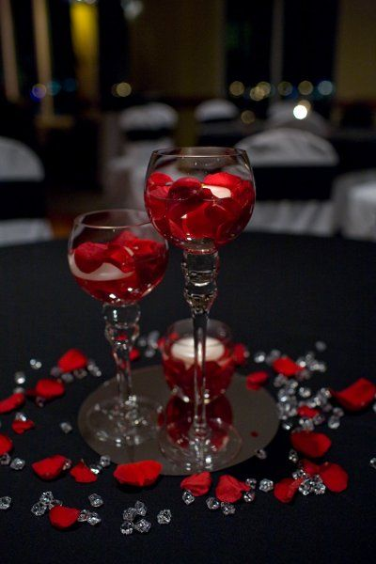
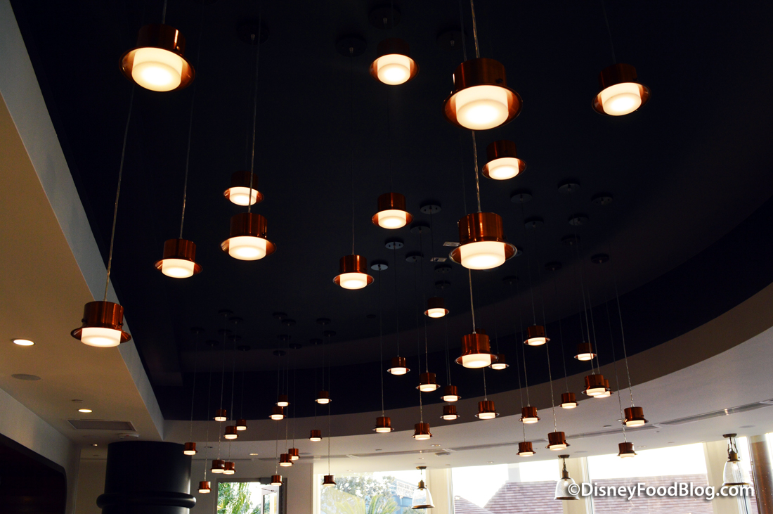

WELCOME- EXPERIENCE – GOAN THEME
Check-in
Collaterals
Goodies
Welcome Musicians
Welcome Engagements

Slide 12
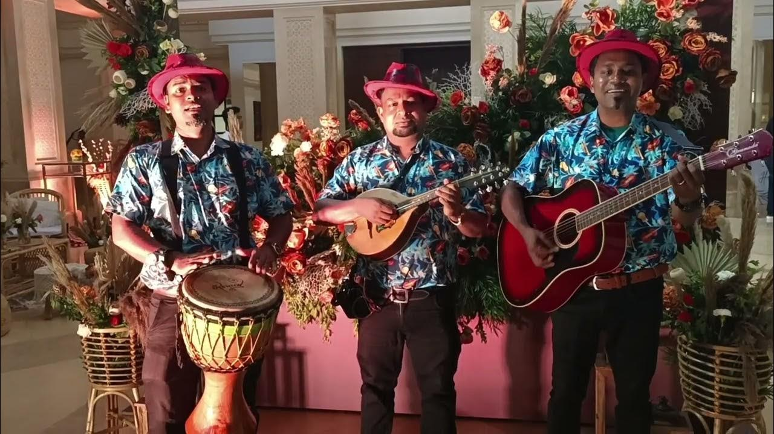
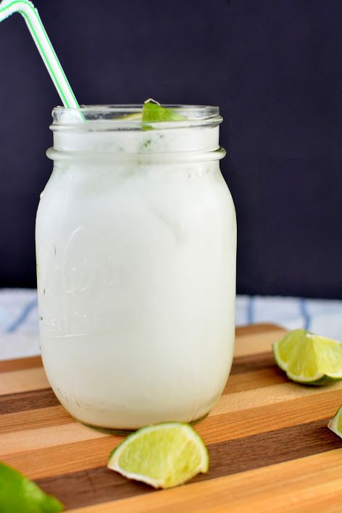
WELCOME- EXPERIENCE
Welcome Serenaders
Coconut Juice with Logo print

Slide 13
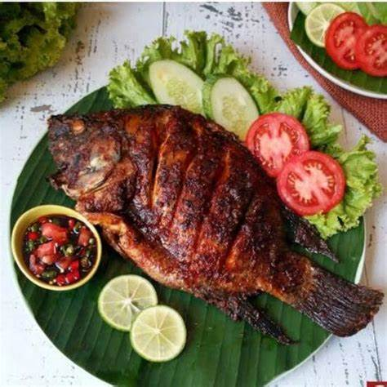
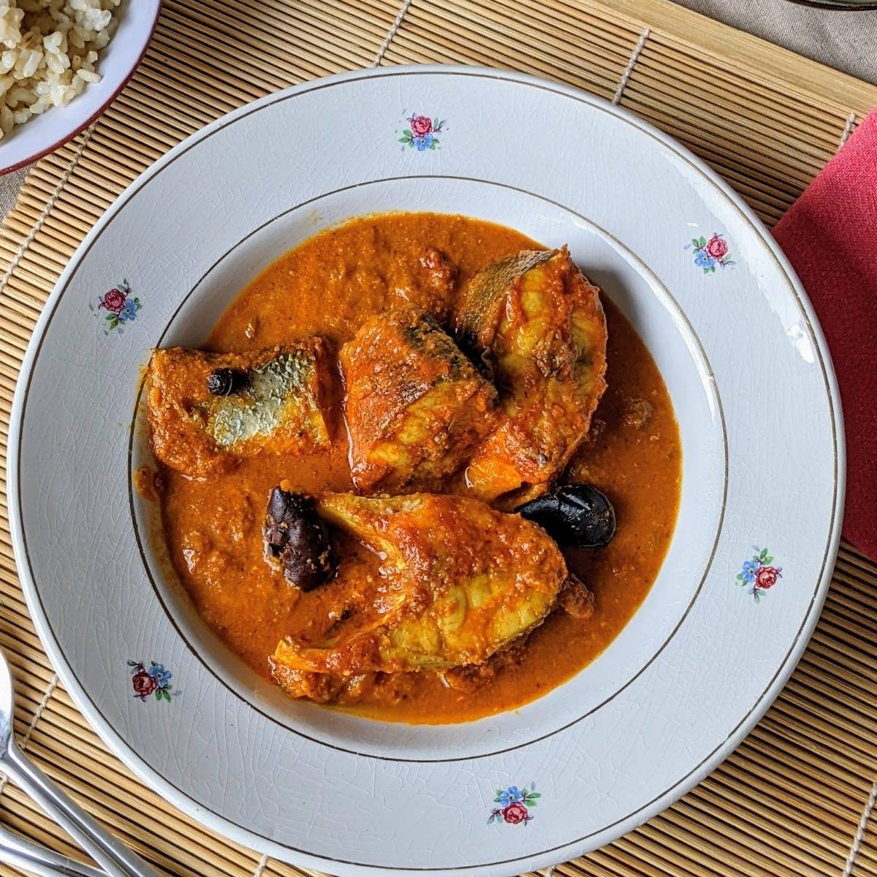
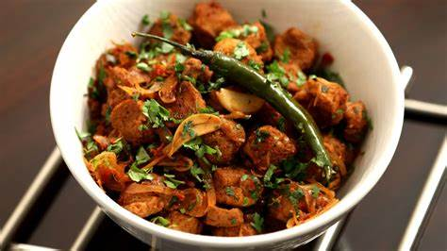
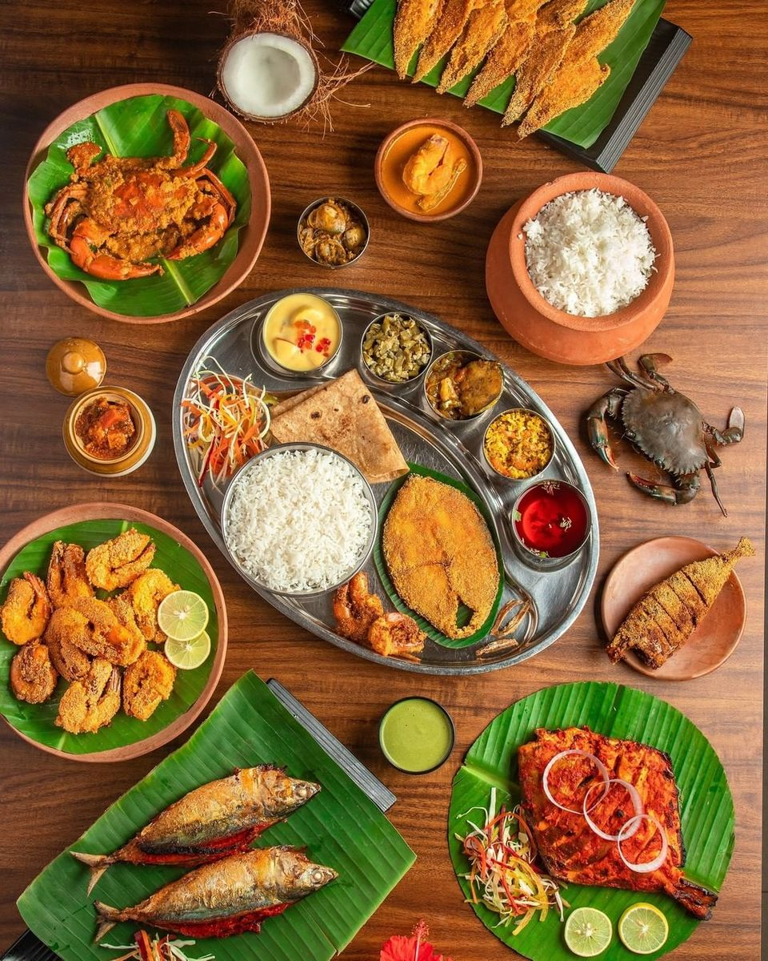
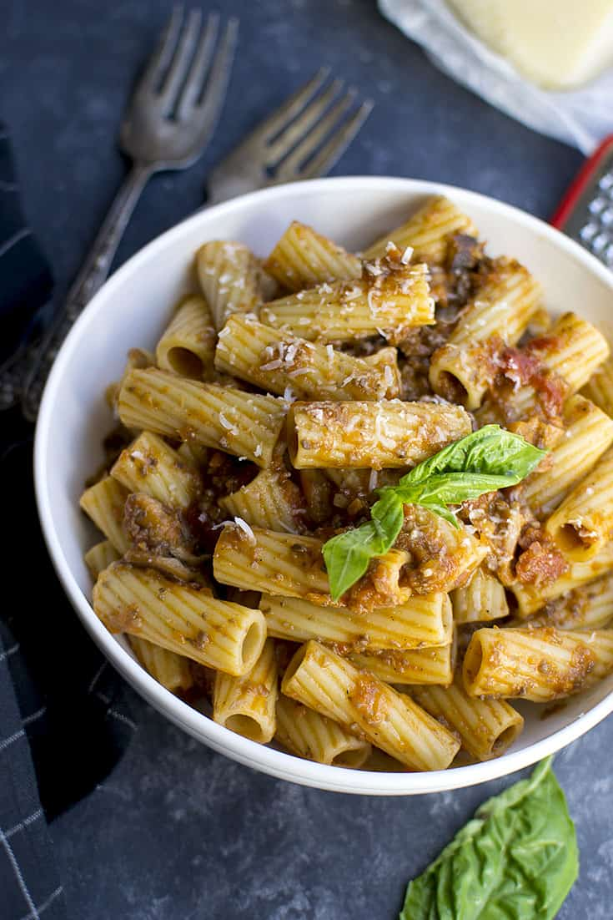


Slide 14
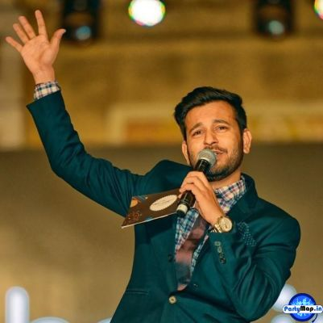
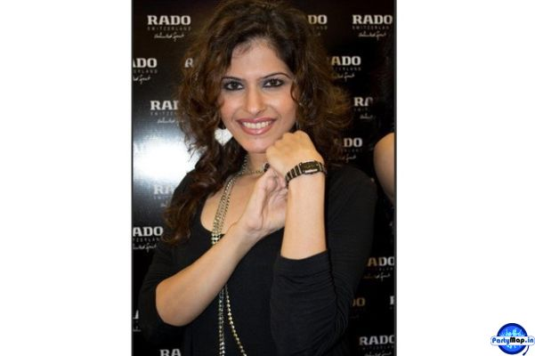
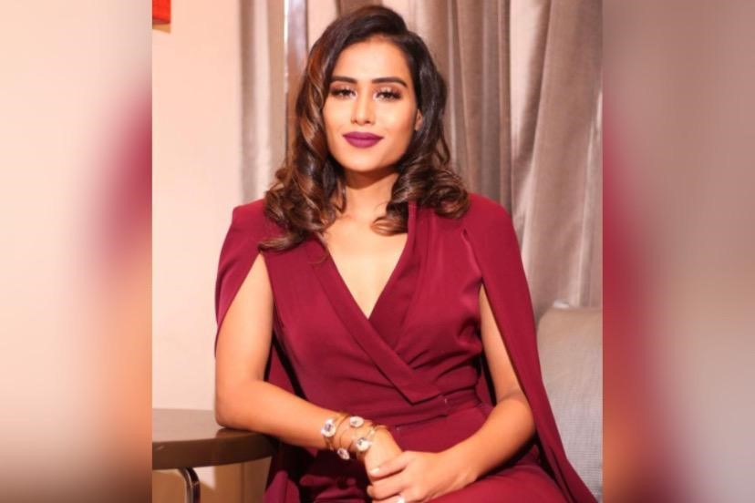
EMCEE
Mitin Upadhyay
Dilruba Pandey
Angela Rebello

Slide 15
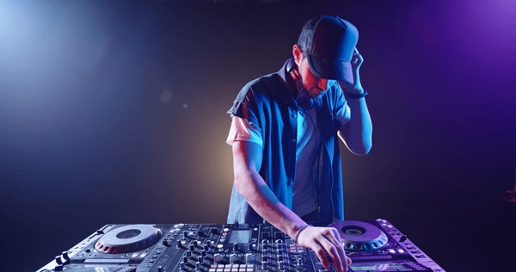
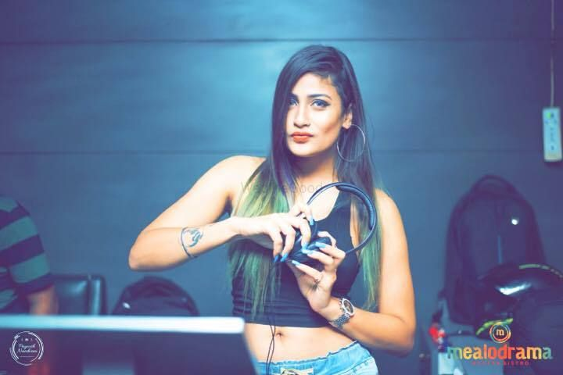
DJ OPTIONS
DJ Harder
DJ Perisha

Slide 16

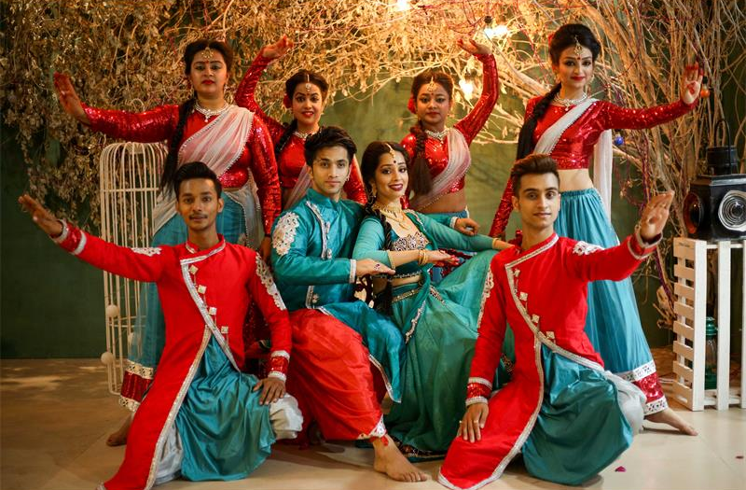
KATHAK ROCKERS

